Slide 1



Welcome you all
Course: CSS
CSS Background
.

Slide 2


Slide 3
CSS defines three types of gradients
Linear Gradients (goes down/up/left/right/diagonally)
Radial Gradients (defined by their center)
Conic Gradients (rotated around a center point)

Slide 4

CSS Linear Gradients
To create a linear gradient you must define at least two color stops. Color stops are the colors you want to render smooth transitions among. You can also set a starting point and a direction (or an angle) along with the gradient effect.
Syntax:
background-image: linear-gradient(direction, color-stop1, color-stop2, ...);

Slide 5
Direction - Top to Bottom (this is default)
#grad1 {
height: 200px;
background-color: red; /* For browsers that do not support gradients */
background-image: linear-gradient(red, yellow);
}
<div id="grad1"></div>
Direction - Left to Right
#grad { background-image: linear-gradient(to right, red , yellow); }
Direction - Diagonal
#grad { background-image: linear-gradient(to bottom right, red, yellow); }

Slide 6
Using Angles
Syntax
background-image: linear-gradient(angle, color-stop1, color-stop2);
#grad { background-image: linear-gradient(180deg, red, yellow); }
Using Multiple Color Stops
#grad { background-image: linear-gradient(red, yellow, green); }

Slide 7
how to create a linear gradient (from left to right) with the color of the rainbow and some text
#grad1 {
height: 55px;
background-color: red; /* For browsers that do not support gradients */
background-image: linear-gradient(to right, red, orange, yellow, green,
blue, indigo, violet);
}
<div id="grad1" style="text-align:center;margin:auto;color:#888888;font-size:40px;font-weight:bold">
KGiSL Microcollege
</div>

Slide 8
Repeating a linear-gradient
The repeating-linear-gradient() function is used to repeat linear gradients:
#grad { background-image: repeating-linear-gradient(red, yellow 10%, green 20%); }
background-image: linear-gradient(rgba(0, 0, 255, 0.5), rgba(255, 255, 0, 0.5)), url("../../media/examples/lizard.png");

Slide 9
CSS Radial Gradients
A radial gradient is defined by its center.
To create a radial gradient you must also define at least two color stops.
Syntax
background-image: radial-gradient(shape size at position, start-color, ..., last-color);
By default, shape is ellipse, size is farthest-corner, and position is center.
Radial Gradient - Evenly Spaced Color Stops (this is default)
#grad { background-image: radial-gradient(red, yellow, green); }

Slide 10
Radial Gradient - Differently Spaced Color Stops
#grad { background-image: radial-gradient(red 5%, yellow 15%, green 60%); }
Set Shape
The shape parameter defines the shape. It can take the value circle or ellipse. The default value is ellipse.
#grad { background-image: radial-gradient(circle, red, yellow, green); }

Slide 11
Use of Different Size Keywords
The size parameter defines the size of the gradient. It can take four values:
closest-side
farthest-side
closest-corner
farthest-corner

Slide 12
#grad1 { background-image: radial-gradient(closest-side at 60% 55%, red, yellow, black); } #grad2 { background-image: radial-gradient(farthest-side at 60% 55%, red, yellow, black); }
Repeating a radial-gradient
#grad { background-image: repeating-radial-gradient(red, yellow 10%, green 15%); }

Slide 13
CSS Conic Gradients
A conic gradient is a gradient with color transitions rotated around a center point.
To create a conic gradient you must define at least two colors.
Syntax
background-image: conic-gradient([from angle] [at position,] color [degree], color [degree], ...);

Slide 14

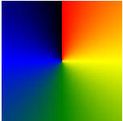
Conic Gradient: Three Colors
The following example shows a conic gradient with three colors
#grad { background-image: conic-gradient(red, yellow, green); }
Conic Gradient: Five Colors
The following example shows a conic gradient with five colors:
#grad { background-image: conic-gradient(red, yellow, green, blue, black); }

Slide 15
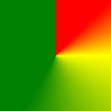
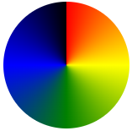
Conic Gradient: Three Colors and Degrees
#grad { background-image: conic-gradient(red 45deg, yellow 90deg, green 210deg); }
Create Pie Charts
Just add border-radius: 50% to make the conic gradient look like a pie:
#grad { background-image: conic-gradient(red, yellow, green, blue, black); border-radius: 50%; }

Slide 16
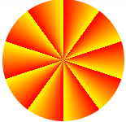
Repeating a Conic Gradient
The repeating-conic-gradient() function is used to repeat conic gradients:
#grad { background-image: repeating-conic-gradient(red 10%, yellow 20%); border-radius: 50%; }
#grad { background-image: repeating-conic-gradient(red 0deg 10deg, yellow 10deg 20deg, blue 20deg 30deg); border-radius: 50%; }

Slide 17

The background-attachment CSS property sets whether a background image's position is fixed within the viewport, or scrolls with its containing block.

Slide 18
background-attachment: scroll;
background-attachment: fixed;
background-attachment: local;
background-attachment: local, scroll;
background-attachment: scroll, local;
<p>
There were doors all round the hall, but they were all locked; and when Alice
had been all the way down one side and up the other, trying every door, she
walked sadly down the middle, wondering how she was ever to get out again.
</p>
p {
background-image: url(“img.gif");
background-attachment: fixed;
}

Slide 19
Multiple background images
This property supports multiple background images. You can specify a different <attachment> for each background, separated by commas. Each image is matched with the corresponding <attachment> type, from first specified to last.
<p> There were doors all round the hall, but they were all locked; and when Alice had been all the way down one side and up the other, trying every door, she walked sadly down the middle, wondering how she was ever to get out again. Suddenly she came upon a little three-legged table, all made of solid glass; </p>
p {
background-image: url("starsolid.gif"), url("startransparent.gif");
background-attachment: fixed, scroll;
background-repeat: no-repeat, repeat-y;
}

Slide 20
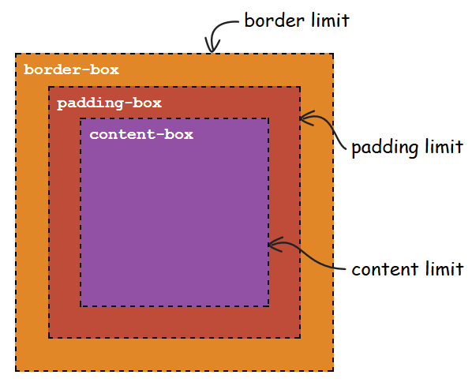
background-clip
The background-clip CSS property sets whether an element's background extends underneath its border box, padding box, or content box.
background-clip: border-box;
background-clip: padding-box;
background-clip: content-box;
background-clip: text; -webkit-background-clip: text; color: transparent;

Slide 21
border-box
The background extends to the outside edge of the border (but underneath the border in z-ordering).
padding-box
The background extends to the outside edge of the padding. No background is drawn beneath the border.
content-box
The background is painted within (clipped to) the content box.
Text
The background is painted within (clipped to) the foreground text.

Slide 22
HTML File
<p class="border-box">The background extends behind the border.</p>
<p class="padding-box">
The background extends to the inside edge of the border.
</p>
<p class="content-box">
The background extends only to the edge of the content box.
</p>
<p class="text">The background is clipped to the foreground text.</p>

Slide 23
p {
border: 0.8em darkviolet;
border-style: dotted double;
margin: 1em 0;
padding: 1.4em;
background: linear-gradient(60deg, red, yellow, red, yellow, red);
font: 900 1.2em sans-serif;
text-decoration: underline;
}
.border-box {
background-clip: border-box;
}
.padding-box {
background-clip: padding-box;
}
.content-box {
background-clip: content-box;
}
.text {
background-clip: text;
-webkit-background-clip: text;
color: rgba(0, 0, 0, 0.2);
}

Slide 24

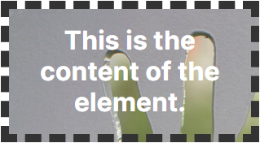
background-origin
The background-origin CSS property sets the background's origin: from the border start, inside the border, or inside the padding.
background-origin: border-box; background-repeat: no-repeat;
background-origin: padding-box; background-repeat: no-repeat;

Slide 25
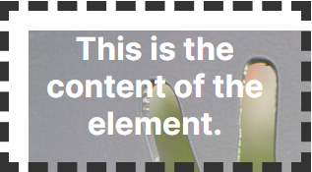
background-origin: content-box; background-repeat: no-repeat;
border-box
The background is positioned relative to the border box.
padding-box
The background is positioned relative to the padding box.
content-box
The background is positioned relative to the content box.

Slide 26
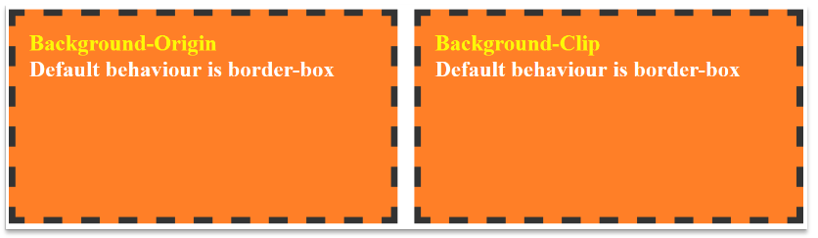
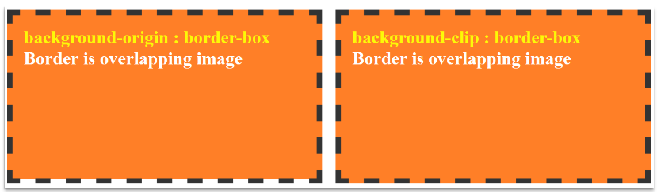

Slide 27
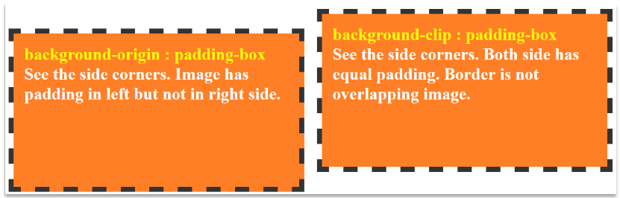
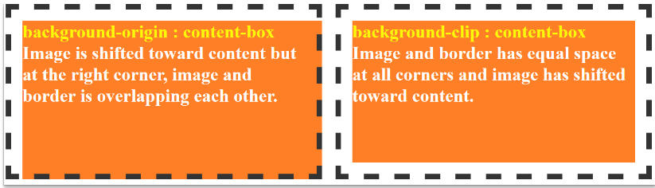

Slide 28
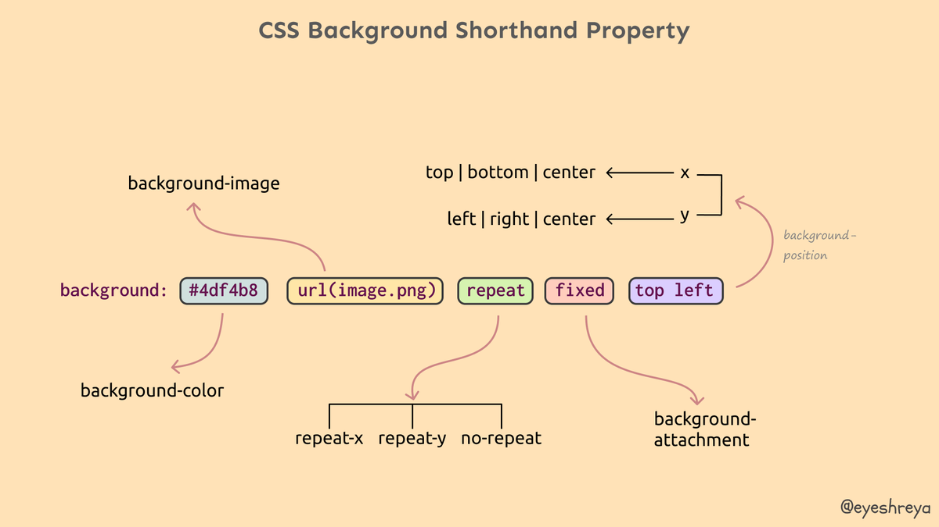

Slide 29



Thank You

